Slide 1
Action Research Project 24/25
What is the estimated environmental impact* of my everyday use of the UAL digital tools and services, as an academic staff member of UAL (LCF/LCC)?
Greg Orrom Swan
* in terms of GHG emissions / kg of CO2e
Notes:
Start with my research question

Slide 2
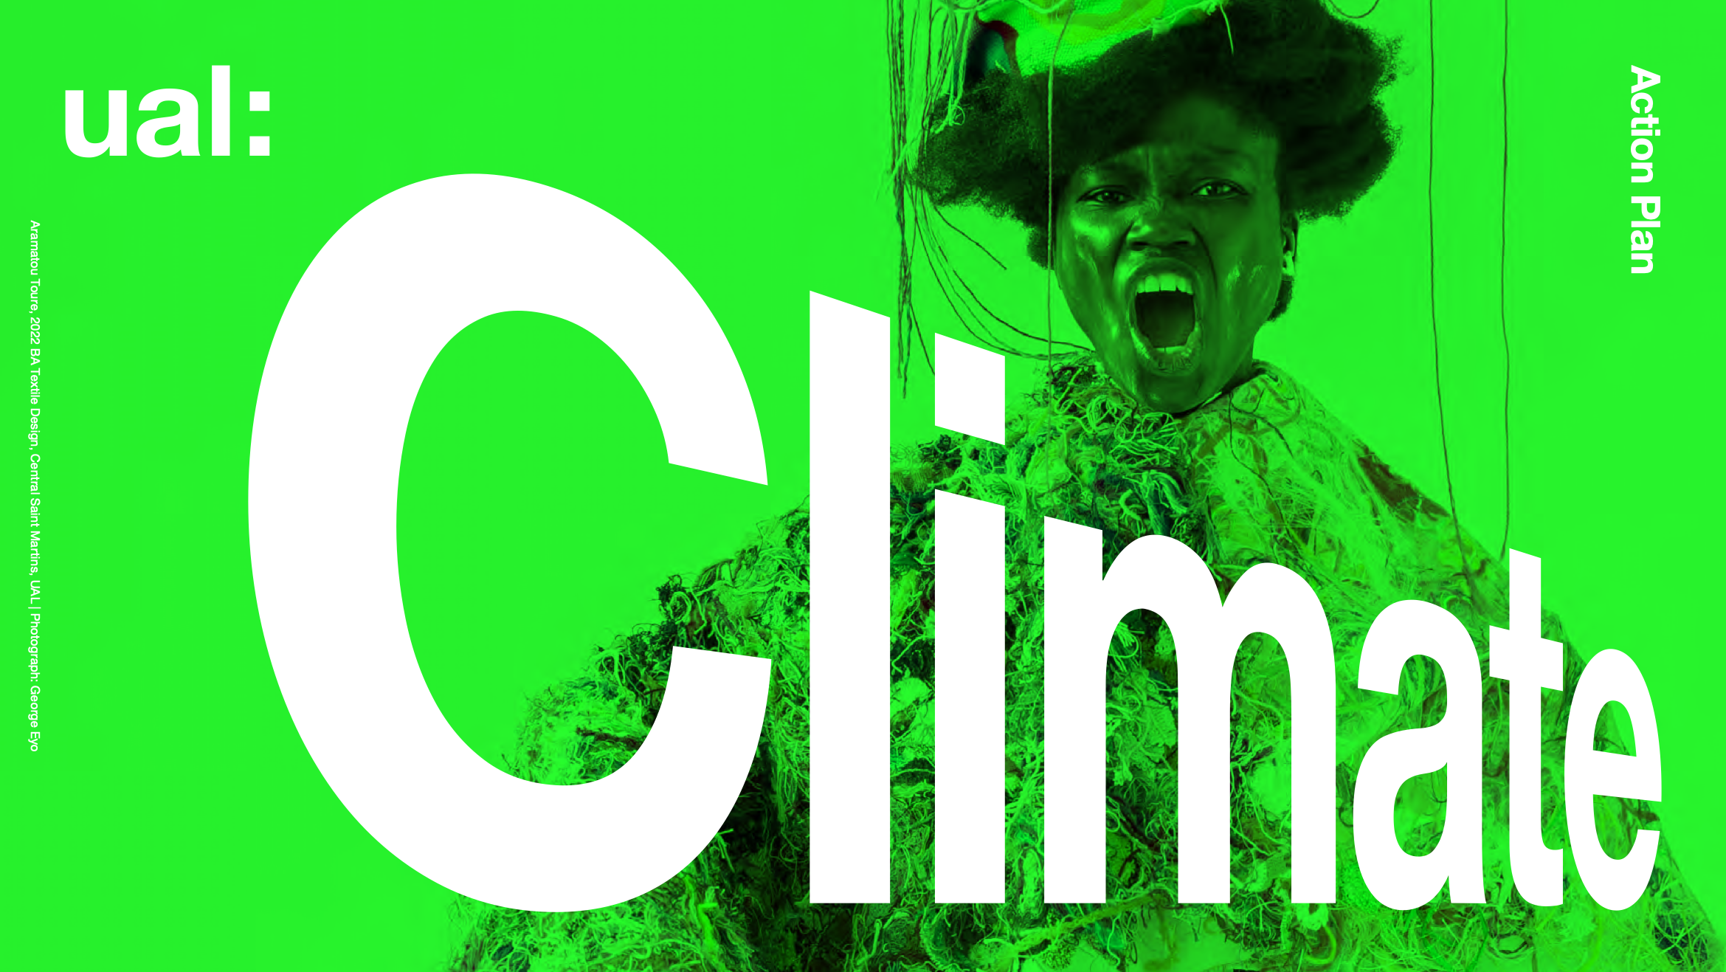
Context
The world is literally burning.
Manufacturing digital devices, their use, and extractivist practices around raw materials contribute to anthropogenic climate change. This disproportionally affects the global majority.
UAL has produced a ‘Climate Action Plan’ in 2022/23
The Guardian, 2021
Poynting, 2025; UAL, 2023; Greene-Dewasmes, 2023; Acosta, 2013
Notes:
No explanation needed. Insert your own image here of climate collapse (passed 1.5°c above pre-industrial levels) last year.
Digital devices are made with raw materials which continue extractivist practices; colonial commodification of land for raw materials — resulting uneven wealth distribution — extreme weather affecting global south more
As you’re aware: UAL’s Climate Action Plan; Climate Justice team, Climate Network etc

Slide 3
Rationale
I teach using digital technologies; I teach mostly digital software across 22 courses at LCF, and 2 courses at LCC. My impact from digital tools and devices is therefore implicit within my teaching context.
What then, is my impact by using these digital tools? To teach, communicate, etc. Should I change? Should we change?
A desire to interrogate UAL’s institutional position
Notes:
What this means is that I want to ‘start at home’ — work out my impact, in my pedagogical context
When I use these digital tools, what does it do?
Want to interrogate UALs climate charter, plan etc

Slide 4
Research Methods + Data Gathering
quant data only
eg volume of emails
gathered data after it happened
gather the quantitative data by counting occurrences
on myself
retrospective auto-quantitative direct-measurement method
using a STRUCTURED (almost SYSTEMATIC) approach
repeatable by me or others
rigorous (it felt rigorous to me, but its probs not actually systematic)
10 day sample period. ‘Truly’ randomly generated start date of: 02 Dec 2024
Alvesson, 2003; Hara, 2015; INTRAC, 2017; Jamieson, et al. 2023; Poerwandari, 2021; Sage, 2024;
Notes:
So, how did I gather data?
Participant bias — Researcher bias are of course present in this study, which is explored a little in the blog
10 days sample period bc 1/3 of average Gregorian month
To attempt to reduce bias, gathered data after it happened. Selected a month range, then generated a ‘truly’ random date within that time to to decide sample period: 2.12.2024. [space dust hitting a satellite]

Slide 5
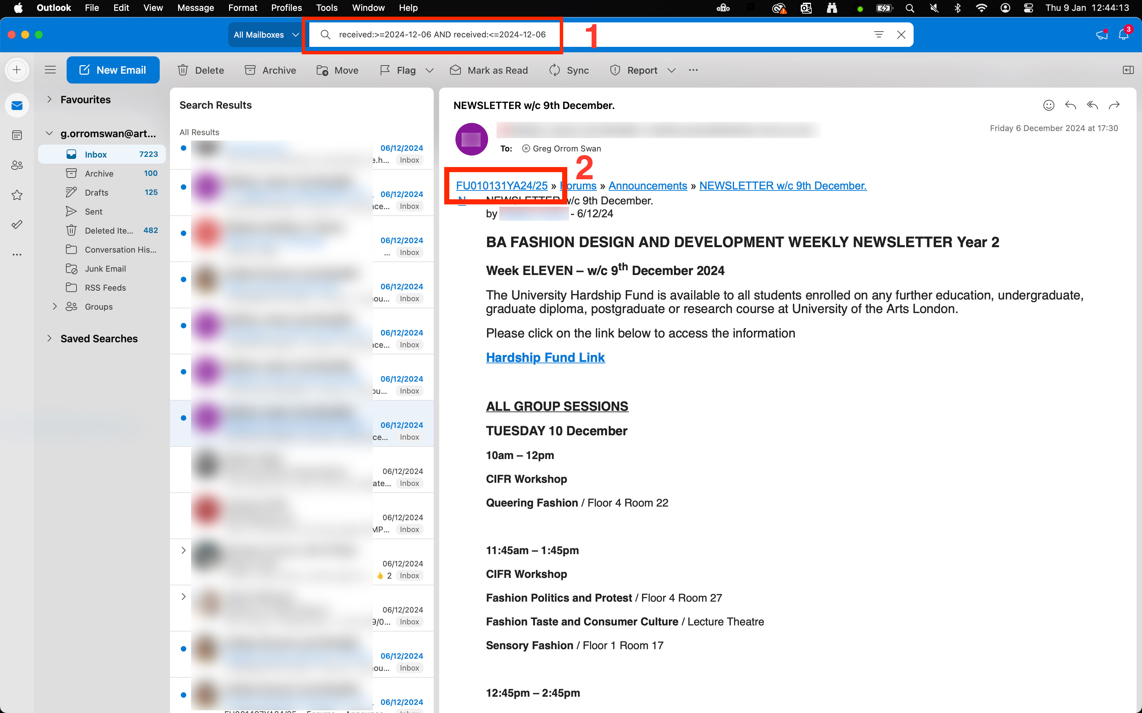
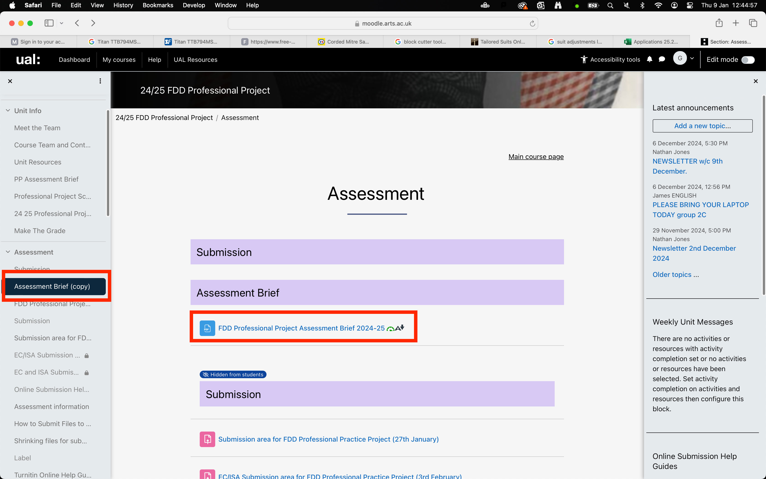
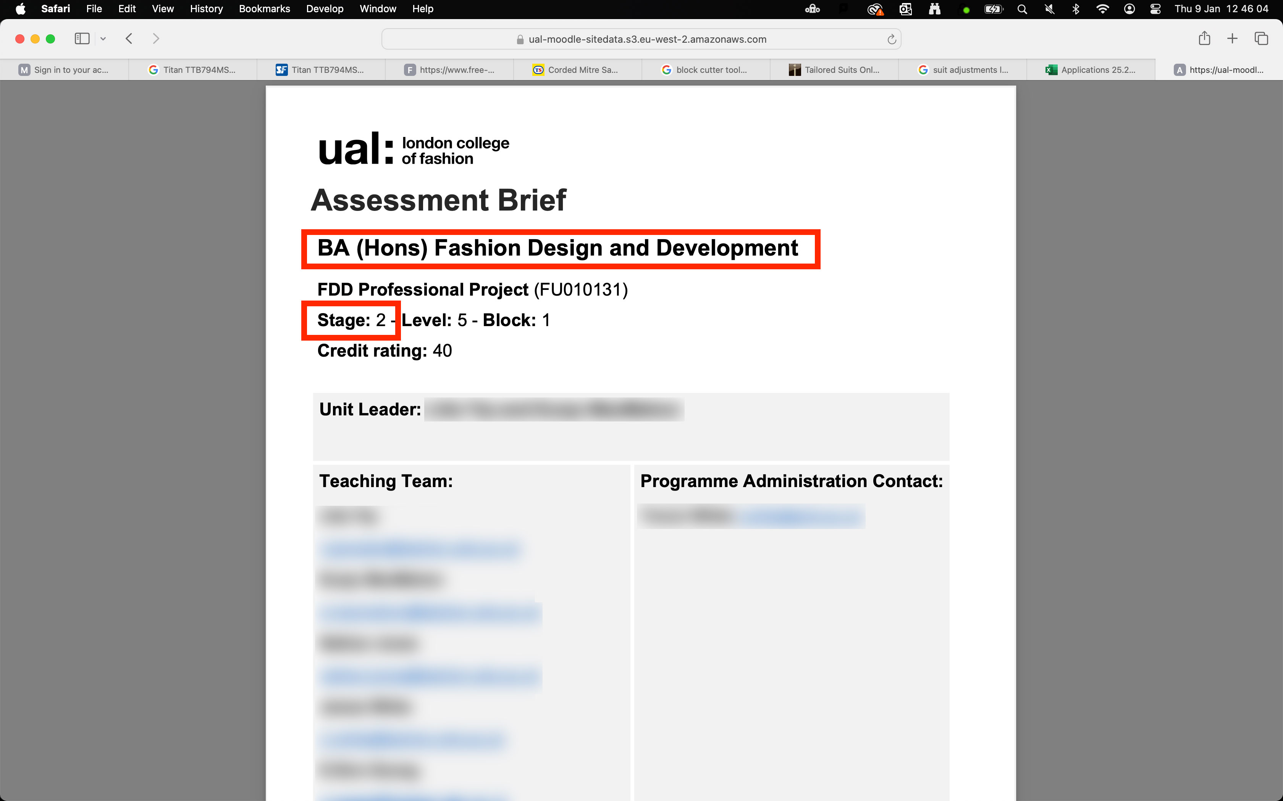
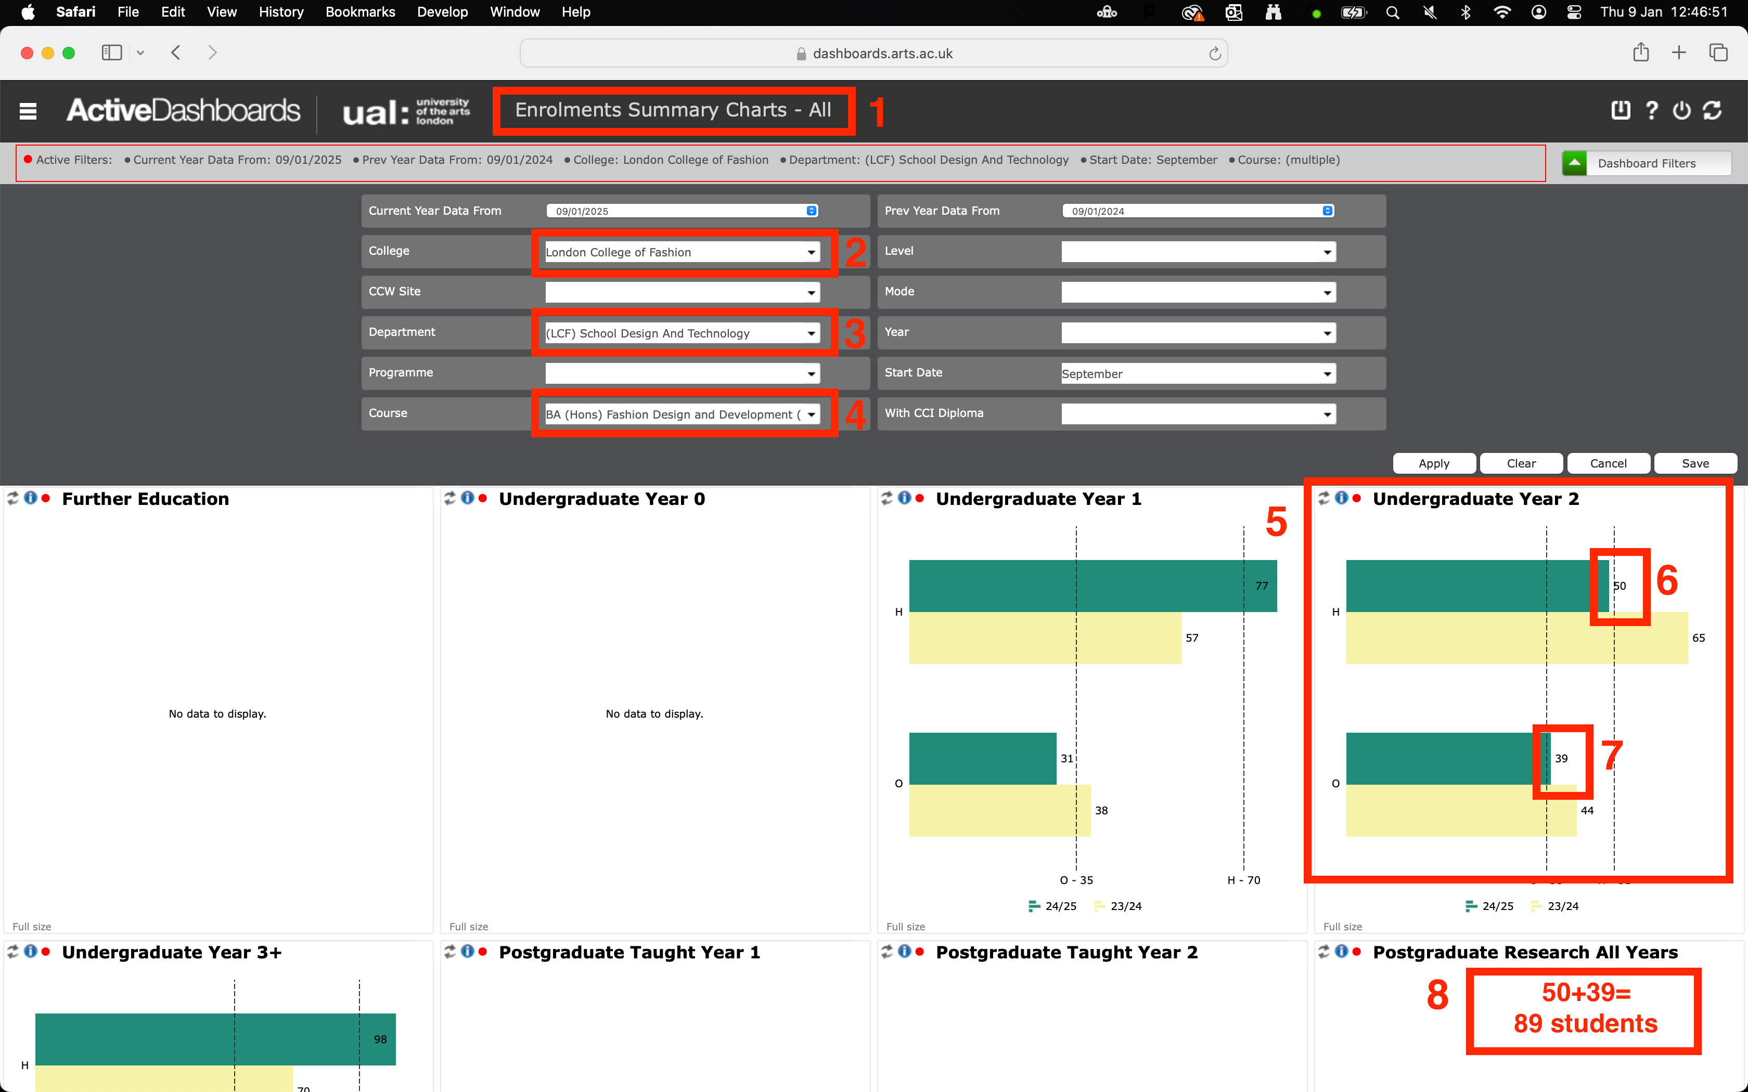
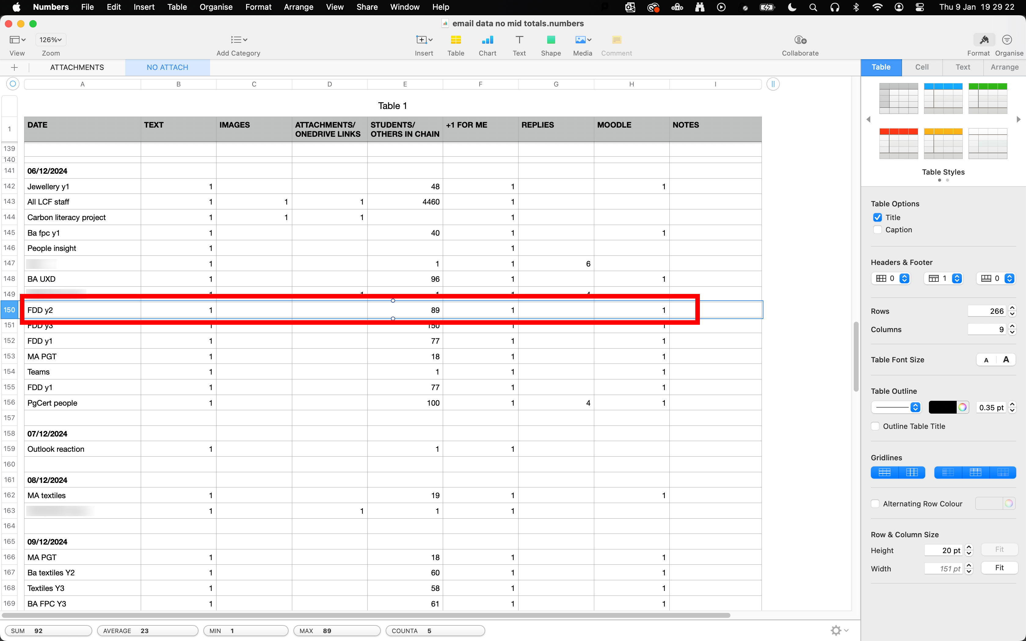
Research Methods + Data Gathering
Notes:
Quick overview of my data gathering process for emails
Filter date of sample period (1), select email if recipients obv, mark down how many emails, replies etc. If not obviousI follow link to moodle page (2)
On Moodle, find assessment brief, open it
Know I know which course and year the Moodle email was sent to
Go to UAL ActiveDashboards > enrolments > find course (FDD) and then add up current 24/25 data from home+overseas = 89
Then go to spreadsheet and add 89 students to Column E of students/others in email chain
Repeat this for all 335 emails of the sample period…

Slide 6
Findings + Data Analysis
TOTAL EMAILS RECEIVED: 335
Average energy intensity model:
17g × 335 emails = 5695g
Power Model:
5695g × 0.207 (20.7%)
= 1178.86g
= ~1.17kg CO2e
Quasi-statistical analysis
My CO2e impact is tiny, and therefore statistically meaningless. But any (minor) impact is still empirical and still measurable.
Devices themselves are much more environmentally damaging than their use.
Students receive a lot of emails. (one MA course received 22 Moodle emails in 10 days) Does this impact them? What would happen if we changed that?
Malmodin 2024; Morton, 2016; Berners-Lee, 2020; Carbon Literacy, 2022
Notes:
Using quasi-statistical analysis of counting and comparing data
Key takeaway here is: that the CO2e impact is statistically meaningless in comparison to say driving a car, or catching a short flight, let alone a long one.
Manufacturing of devices is the most damaging (embodied carbon)
An interesting, unexpected finding is that as I receive emails from Moodle as if I were a student: they receive a lot of email

Slide 7
Findings + Data Analysis
UAL, 2023;
*Source: Malmodin 2024; Berners-Lee, 2020, Carbon Literacy, 2022
Notes:
Key takeaway here is that the impact is statistically meaningless

Slide 8
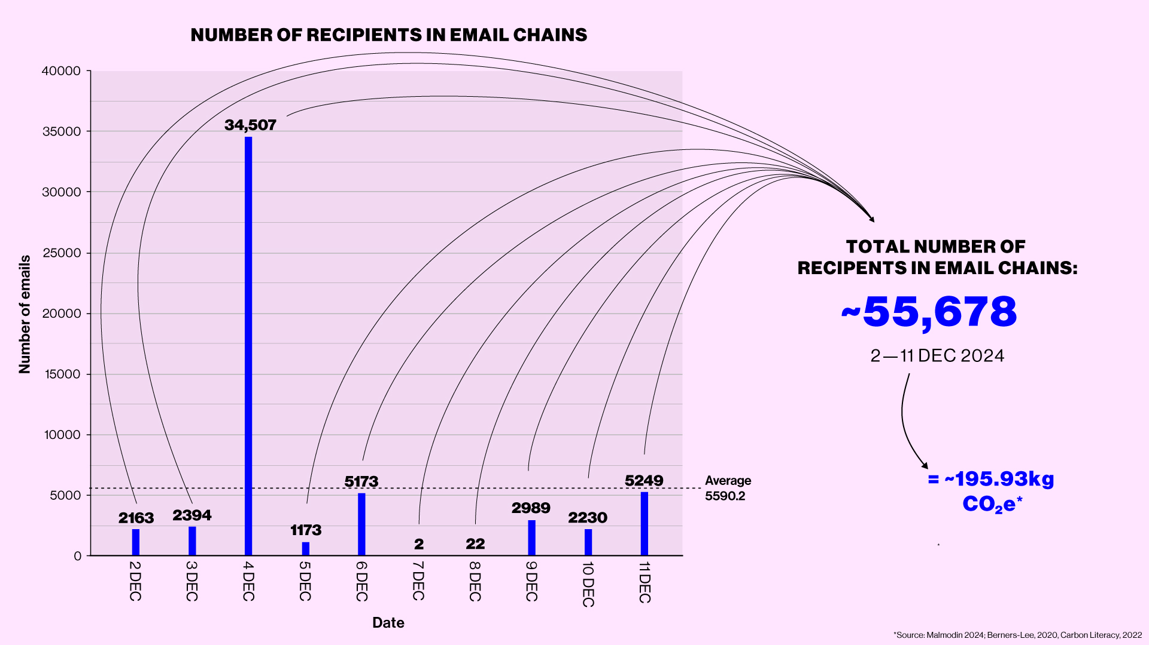
Findings + Data Analysis
Data vis
UAL, 2023;
*Source: Malmodin 2024; Berners-Lee, 2020, Carbon Literacy, 2022
Notes:
This figure of ~55,000 emails, when multiplied by the same metric does appear signifiant at ~195kg CO2e.
But this figure is still less than a return flight from London to Rome

Slide 9
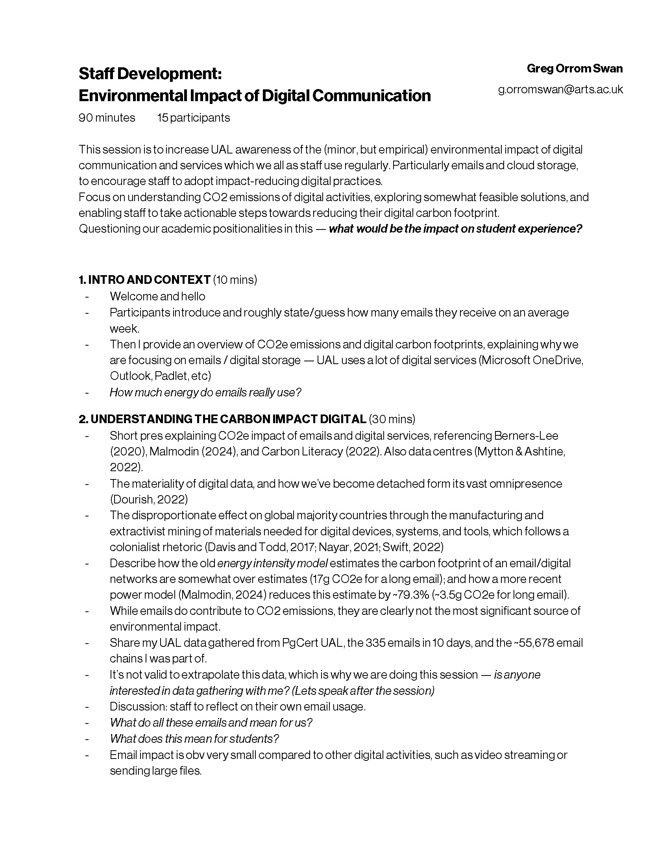
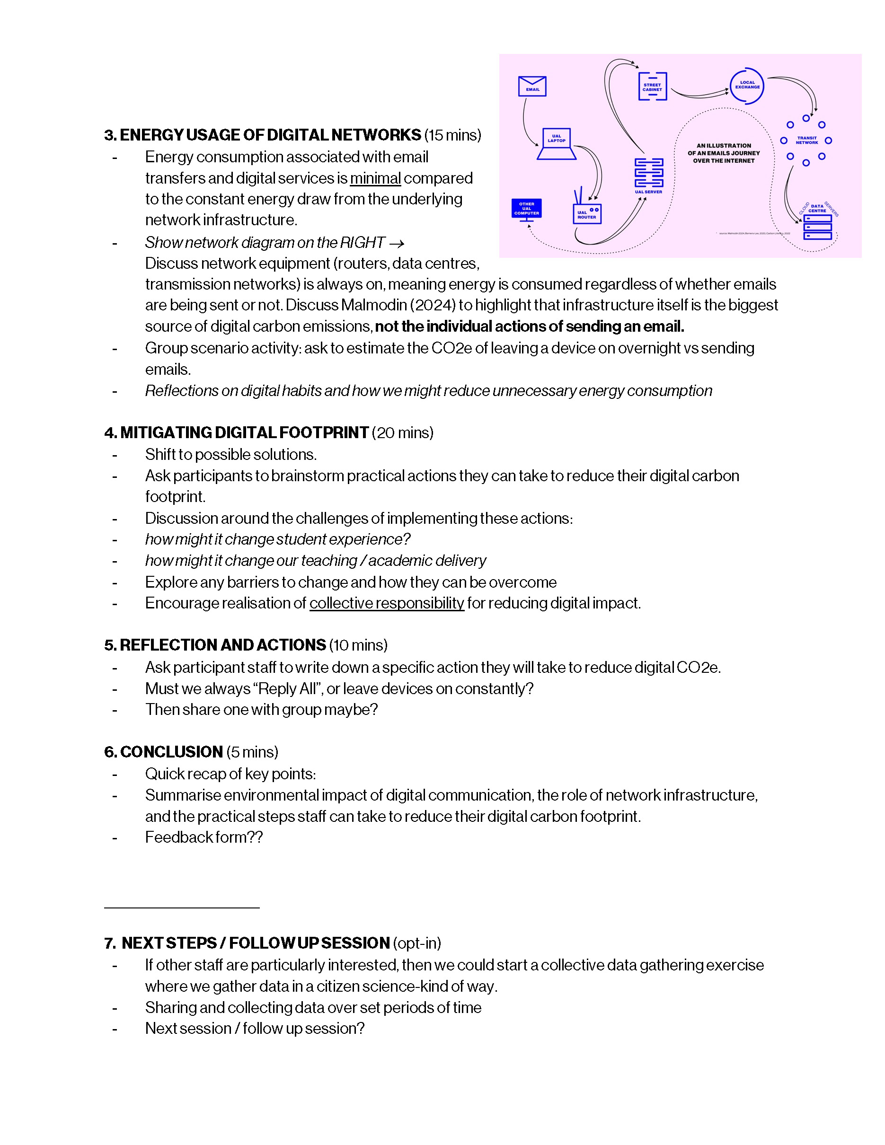
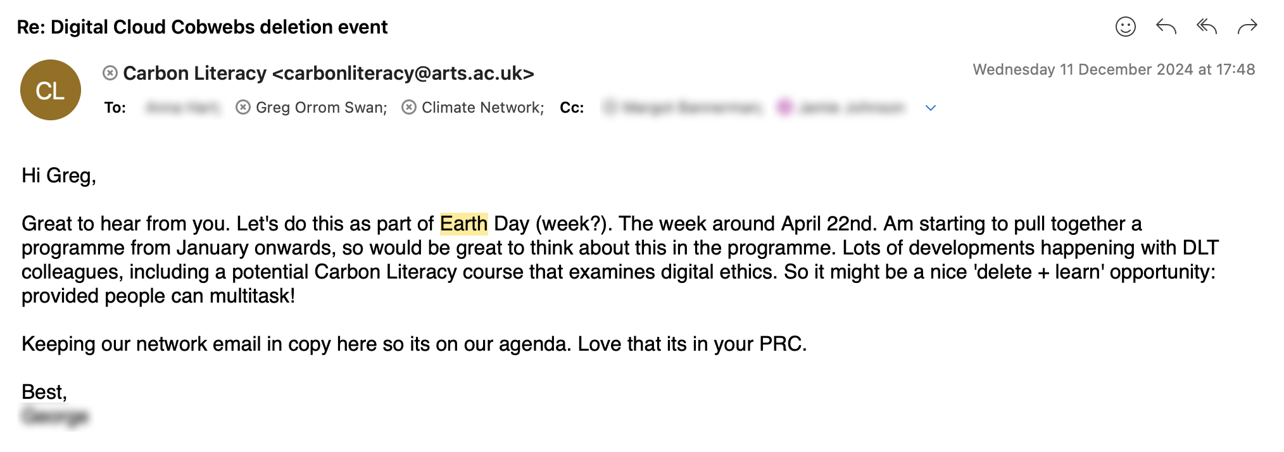
Actions
Staff development lesson plan
Digital cobweb clear-out (email deletion) event. Earth Day 2025 [22 April]
Personal knowledge growth, small changes I will make. eg. Previously wanted my UAL laptop to be upgraded, but now I recognise its still fit for purpose.
Notes:
My data isn’t very meaningful by its own (a limitation) Acknowledging that its also low impact, compared to flights lets say, but it still starts a convo on impact of digital tools. Running a knowledge sharing staff dev, where we could communalise/democratise data gathering, in citizen science kinda way — knowledge sharing on how to data gather, then we can compare
Although deleting emails, or not sending is statistically meaningless in terms of carbon impact, I still feel there is value in raising wider awareness about the impact of our digital tools addiction. Started this, with some people from CSM for earth day.
Key takeaway is that I understand my impact, and its not much. But thats ok. I have enabled myself to interrogate further

Slide 10
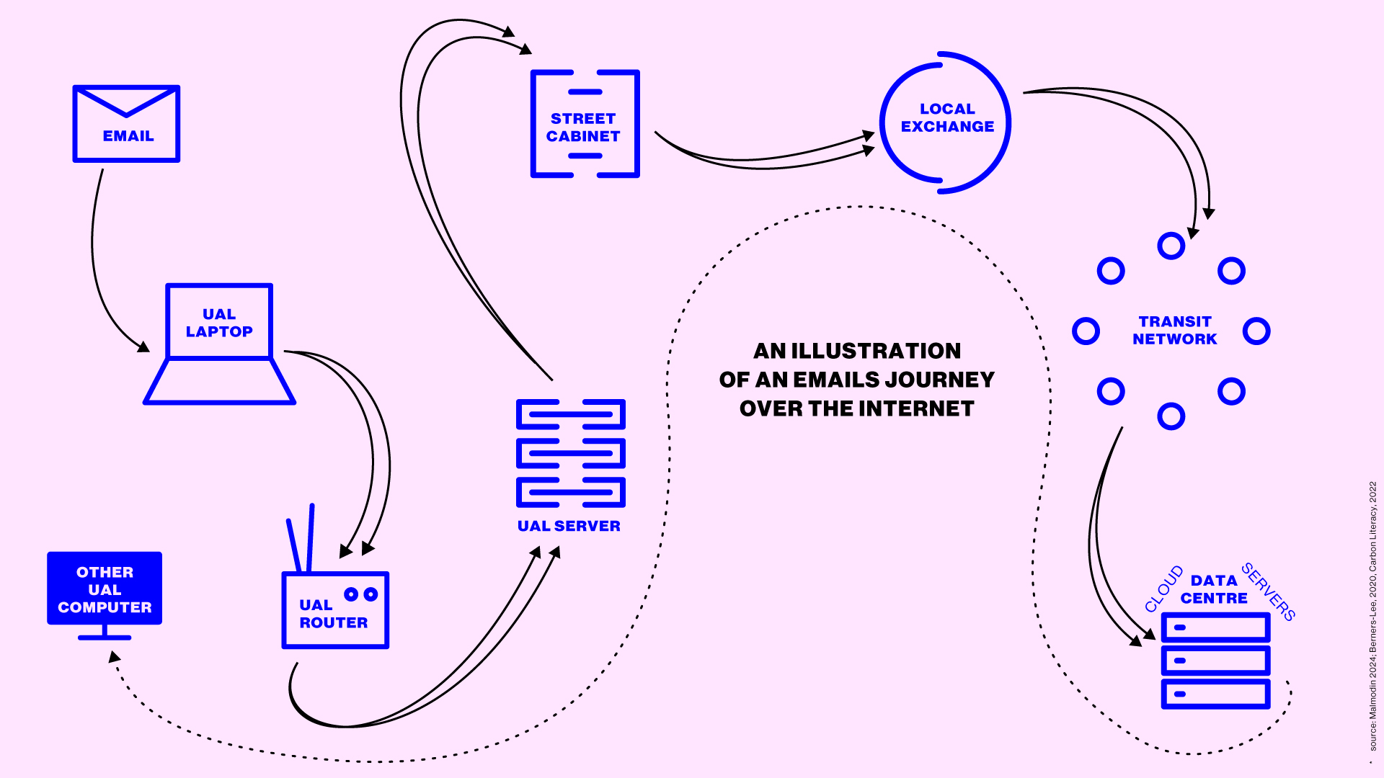
Actions
Source: Malmodin 2024; Berners-Lee, 2020, Carbon Literacy, 2022
Notes:
Here is an illustration I made of an emails journey across the internet, which I thought it would be nice to share with you.
A teaching asset for the staff development

Slide 11
Reflections + Futuring
My project feels a little utilitarian and meek, but I have personally grown in knowledge.
Further research ideas:
I looked at transfer of data, not storage — what is the impact of storing unused UAL ‘dark data’ on the cloud?
Research in to UAL’s digital device lifecycles. “30% was migrated from previous LCF sites” what happened to the rest?!
Students receive many emails — do they take it in? Are there alternative (better?) ways? What happens to student experience if it changes?
EC has given me empathetic understanding from a student perspective.
Jackson and Hodgkinson, 2024
Notes:
Thinking ahead, beyond or after the actions
What is impact of storing unused data, as I focused on transference of data. I personally have lots of stuff stored which I don’t use, think about all those Padlets, Moodle pages, etc
I attended a meeting which stated this 30% as somehow a good thing, but what happened to the rest?
This was an unexpected finding, as I mostly ignore them, but it relates it back to the qualitative nature of action research
EC, has offered me empathy, of the increasingly common situational reality to feel like you need an EC

Slide 12
Reference List
Alvesson, M. (2003) Methodology for close up studies – Struggling with closeness and closure. Higher Education, 46, 167–193.
Barad, K. (2007) Meeting the universe halfway: Quantum physics and the entanglement of matter and meaning. Durham, NC: Duke University Press.
Berners-Lee, M. (2020). How bad are bananas?: The carbon footprint of everything. London: Profile.
Blum, A. (2012) Tubes: A journey to the center of the internet. New York, NY: Collins.
Carbon Literacy. (2022) The carbon cost of an email: Update!, The Carbon Literacy Project. Available at: https://carbonliteracy.com/the-carbon-cost-of-an-email/ (Accessed: January 13, 2025).
Carbon Trust (2021) Carbon impact of video streaming, The Carbon Trust. Available at: https://www.carbontrust.com/resources/carbon-impact-of-video-streaming (Accessed: January 11, 2025).
Creative Review (2012) 05: Tesco (1993) – Every Little Helps, Creative Review. Available at: https://www.creativereview.co.uk/every-little-helps/ (Accessed: January 13, 2025).
D’Ignazio, C. and Klein, L.F. (2020) Data Feminism. London, England: MIT Press.
Davis, H. (2023) “Waiting in Petro-time,” Environmental humanities, 15(3), pp. 52–64. Available at: https://doi.org/10.1215/22011919-10745979.
Davis, H. and Todd, Z. (2017) On the Importance of a Date, or Decolonizing the Anthropocene. “, 16(4), pp.761-780.
Delamont, S. (2009) The only honest thing: Autoethnography, reflexivity and small crises in fieldwork. Ethnography and Education, 4, 51–63.
Dourish, P. (2022) The stuff of bits: An essay on the materialities of information. London, England: MIT Press.
Dubé, D.-E. (2017) This is how much time you spend on work emails every day, according to a Canadian survey, Global News. Available at: https://globalnews.ca/news/3395457/this-is-how-much-time-you-spend-on-work-emails-every-day-according-to-a-canadian-survey/ (Accessed: January 23, 2025).
Eriksson, T. (2010) Being native: Distance, closeness and doing auto/self-ethnography. Art Monitor, 8, 91–100.
Etsy (2016) 'Cloud Jewels: Estimating kWh in the Cloud'. [Online] Available at: https://www.etsy.com/codeascraft/cloud-jewels-estimating-kwh-in-the-cloud/ [Accessed 05 January 2025].
Glossary:Carbon dioxide equivalent (no date) Europa.eu. Available at: https://ec.europa.eu/eurostat/statistics-explained/index.php?title=Glossary:Carbon_dioxide_equivalent (Accessed: January 13, 2025).
Greene-Dewasmes, G. (2023) Climate week messages from Most Affected People and Areas, World Economic Forum. Available at: https://www.weforum.org/stories/2023/10/mapa-voices-key-climate-week-messages-from-most-affected-people-and-areas/ (Accessed: January 20, 2025).
Griffiths, S. (2020) “Why your internet habits are not as clean as you think,” BBC, 6 March. Available at: https://www.bbc.com/future/article/20200305-why-your-internet-habits-are-not-as-clean-as-you-think (Accessed: January 23, 2025).
GSMA (2024) Gsma.com. Available at: https://www.gsma.com/betterfuture/wp-content/uploads/2024/02/Mobile-Net-Zero-2024-State-of-the-Industry-on-Climate-Action.pdf (Accessed: January 13, 2025).
Haahr, M. (2024) Random.org - calendar date generator, Random.org. Available at: https://www.random.org/calendar-dates/ (Accessed: December 19, 2024).
Hamdan, A. (2012) Autoethnography as a genre of qualitative research: A journey inside out. International Journal of Qualitative Methods, 11, 585–606.
HEPI (2024) Decarbonising higher education – the investment challenge, HEPI. Available at: https://www.hepi.ac.uk/2024/06/21/decarbonising-higher-education-the-investment-challenge/ (Accessed: January 20, 2025).
HESA (2024) Who’s working in HE?, Hesa.ac.uk. Available at: https://www.hesa.ac.uk/data-and-analysis/staff/working-in-he#provider (Accessed: 16 December 2024).
IEA (2023) ‘Global Data Centre Energy Consumption 2023’. International Energy Agency. [Online] Available at: https://www.iea.org/reports/global-data-centre-energy-consumption-2023 [Accessed 19 January 2025].
INTRAC (2017). Direct Measurement. [online] M&E Training & Consultancy. Available at: https://www.intrac.org/wpcms/wp-content/uploads/2017/01/Direct-measurement.pdf [Accessed 15 Oct. 2024].
Jackson, T. and Hodgkinson, I. (2024) Decoding the digital carbon footprint: exposing the global data challenge, Chronicle.com. Available at: https://sponsored.chronicle.com/decoding-the-digital-carbon-footprint-exposing-the-global-data-challenge/index.html (Accessed: 1 December 2024).
James Wilson, H. (2012) “You, by the numbers,” Harvard business review, 1 September. Available at: https://hbr.org/2012/09/you-by-the-numbers (Accessed: January 19, 2025).
Jamieson, M.K., Govaart, G.H. and Pownall, M. (2023). Reflexivity in Quantitative research: a Rationale and beginner’s Guide. Social and Personality Psychology Compass, 17(4), pp.1–15. doi:https://doi.org/10.1111/spc3.12735.
Jens Malmodin, Mytton, D., Dag Lundén (2024). Network energy use not directly proportional to data volume: The power model approach for more reliable network energy consumption calculations. Journal of Industrial Ecology, 28(4). doi:https://doi.org/10.1111/jiec.13512.
Kara, H. (2015) Creative research methods in the social sciences: A practical guide. Bristol, England: Policy Press.
Kimmerer, R.W. (2013) Braiding sweetgrass: Indigenous wisdom, scientific knowledge and the teachings of plants. Harlow, England: Penguin Books.
Masanet, E. et al. (2020) “Recalibrating global data center energy-use estimates,” Science (New York, N.Y.), 367(6481), pp. 984–986. Available at: https://doi.org/10.1126/science.aba3758.
McNiff, J., Whitehead, J. (2009). Doing and Writing Action Research. London: Sage
Morton, T. (2018) Dark ecology: For a logic of future coexistence. New York, NY: Columbia University Press.
Nayar, J. (2021) Not So ‘Green’ Technology: The Complicated Legacy of Rare Earth Mining, Harvard International Review. Available at: https://hir.harvard.edu/not-so-green-technology-the-complicated-legacy-of-rare-earth-mining/ (Accessed: January 15, 2025).
Poerwandari, E.K. (2021). Minimizing Bias and Maximizing the Potential Strengths of Autoethnography as a Narrative Research. Japanese Psychological Research, 63(4). doi:https://doi.org/10.1111/jpr.12320.
Poynting, M., Rivault, E. and Dale, B. (2025) “World’s hottest year: 2024 first to pass 1.5C warming limit,” BBC, 10 January. Available at: https://www.bbc.co.uk/news/articles/cd7575x8yq5o (Accessed: January 21, 2025).
Sage (2024) Research Methods Map, Sagepub.com. Available at: https://methods.sagepub.com/methods-map/ (Accessed: December 21, 2024).
SAGE. 2017. 'Data Collection', Project Planner [online]. doi: 10.4135/9781526408563.
Sharon, T. and Zandbergen, D. (2017) “From data fetishism to quantifying selves: Self-tracking practices and the other values of data,” New media & society, 19(11), pp. 1695–1709. Available at: https://doi.org/10.1177/1461444816636090.
Siddik, M.A.B., Shehabi, A. and Marston, L. (2021) “The environmental footprint of data centers in the United States,” Environmental research letters, 16(6), p. 064017. Available at: https://doi.org/10.1088/1748-9326/abfba1.
Swift, J. (2022) Climate activism without intersectionality isn’t enough: Why we need intersectional environmentalism, Black Women Radicals. Available at: https://www.blackwomenradicals.com/blog-feed/leahthomas (Accessed: January 19, 2025).
The National Archives (2023) ‘Digital Services and carbon emissions in the heritage sector: some preliminary findings - Archives sector’. Available at: https://www.nationalarchives.gov.uk/archives-sector/digital-services-and-carbon-emissions-in-the-heritage-sector-some-preliminary-findings/ (Accessed: 16 December 2024).
Tomlinson, B. (2014) Greening Through it: Information Technology for Environmental Sustainability. London, England: MIT Press. Available at: https://doi.org/10.7551/mitpress/8261.001.0001.
UAL (2022) Design Brief for Sustainable Development. Available at: https://www.arts.ac.uk/__data/assets/pdf_file/0019/35371/Sustainability-brief-for-new-build-refurbishment-UAL-v4-April-22.pdf.
UAL (2023a) Carbon Management Plan – realising a net-zero carbon institution by 2040. Available at: https://www.arts.ac.uk/__data/assets/pdf_file/0021/213852/UAL-CMP-v1272.pdf.
UAL (2023b) Environmental policy and management, UAL. Available at: https://www.arts.ac.uk/about-ual/climate-action-plan/change-the-way-we-operate/environmental-policy-and-management (Accessed: January 13, 2025).
UAL (2025) UAL ActiveDashboards, Arts.ac.uk. Available at: https://dashboards.arts.ac.uk (Accessed: January 7, 2025).
UKGOV (2024) The UK’s plans and progress to reach net zero by 2050, Parliament.uk. Available at: https://commonslibrary.parliament.uk/research-briefings/cbp-9888/ (Accessed: January 15, 2025).
UN (2024) COP29 UN Climate Conference Agrees to Triple Finance to Developing Countries, Protecting Lives and Livelihoods, Unfccc.int. Available at: https://unfccc.int/news/cop29-un-climate-conference-agrees-to-triple-finance-to-developing-countries-protecting-lives-and (Accessed: January 15, 2025).
UniversitiesUK (2023) Accelerating the UK tertiary education sector towards net zero, Universitiesuk.ac.uk. Available at: https://www.universitiesuk.ac.uk/topics/climate-and-sustainability/accelerating-uk-tertiary-education (Accessed: January 15, 2025).
WHO (2022) Infodemics and misinformation negatively affect people’s health behaviours, new WHO review finds, Who.int. Available at: https://www.who.int/europe/news-room/01-09-2022-infodemics-and-misinformation-negatively-affect-people-s-health-behaviours--new-who-review-finds (Accessed: January 19, 2025).
Wholegrain Digital (2020) Digital declutter toolkit from, Business Declares. Available at: https://www.wholegraindigital.com/digitaldeclutter/ (Accessed: November 18, 2024).
Whyte, K.P. (2016) Is it colonial déjà vu? Indigenous peoples and climate injustice. In Humanities for the Environment (pp. 102-119). Routledge.
Wolfram, S. (2012) “The Personal Analytics of My Life,” Stephen Wolfram Writings. Available at: writings.stephenwolfram.com/2012/03/the-personal-analytics-of-my-life (Accessed: January 19, 2025)
Zaki, J. (2024) Hope for cynics: The surprising science of human goodness. Little, Brown Book Group.

Slide 14
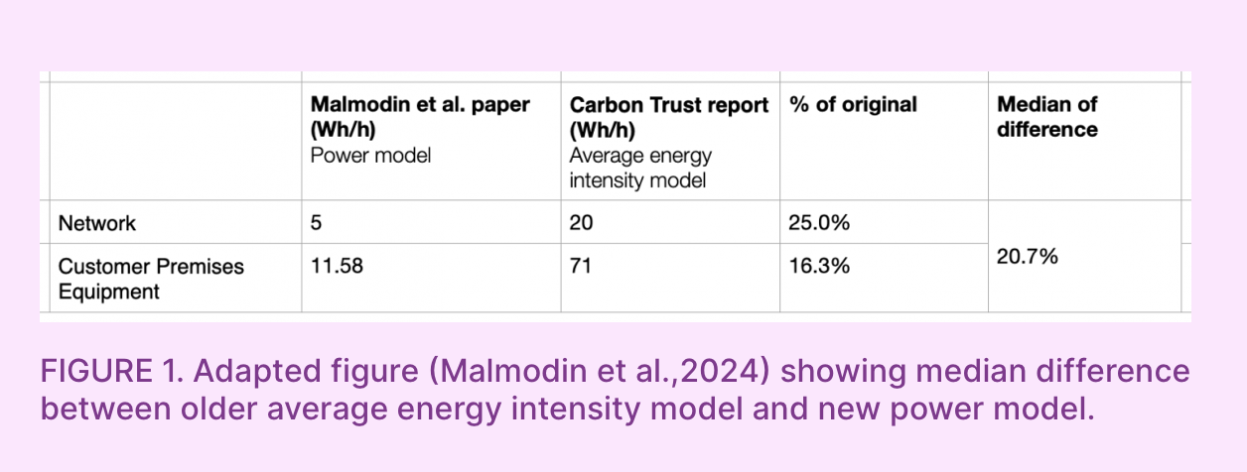
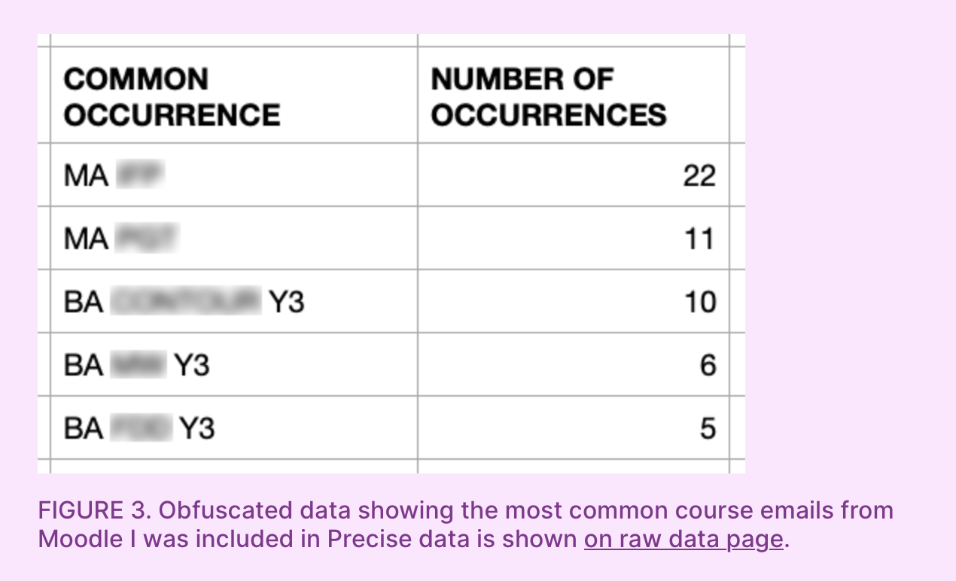
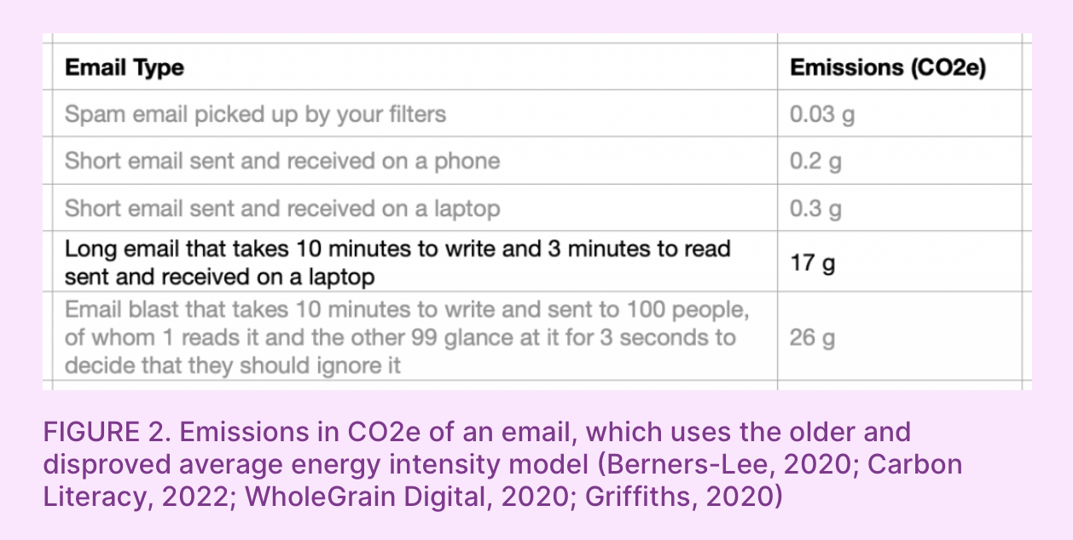
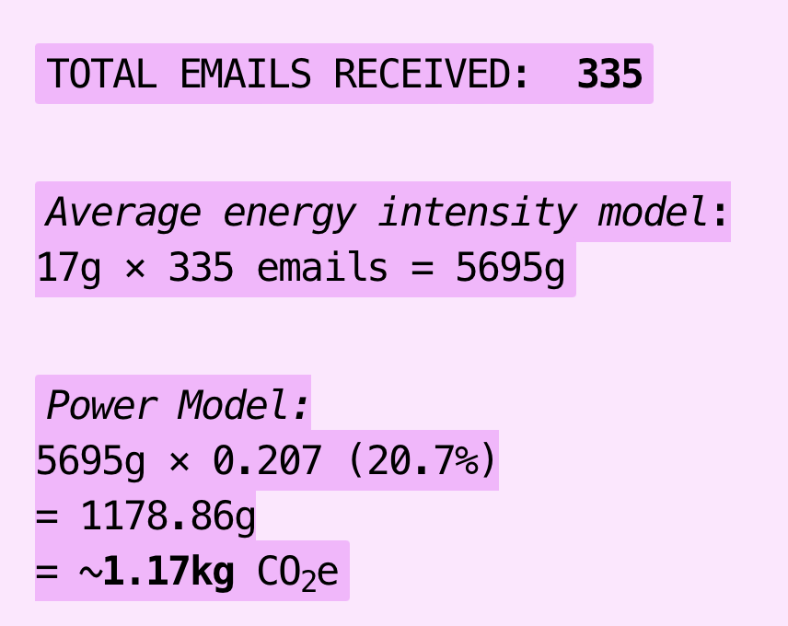
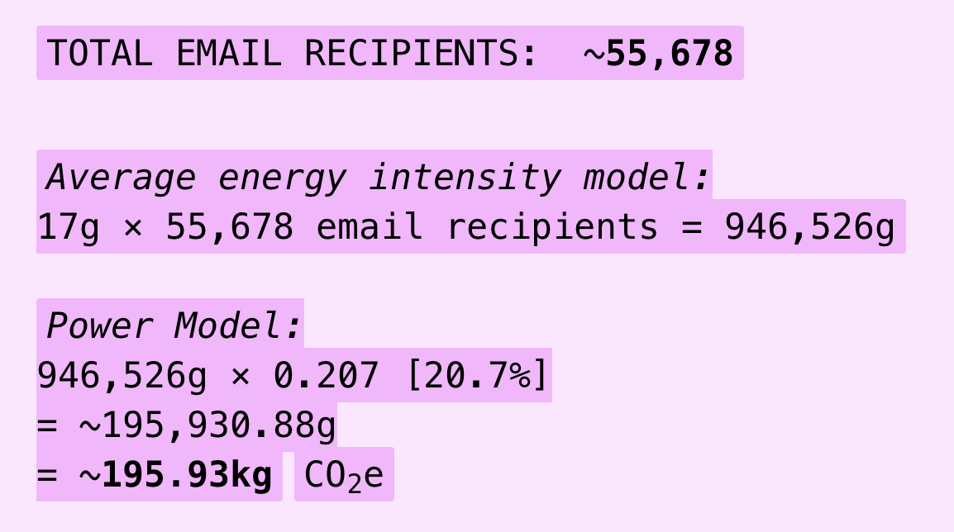
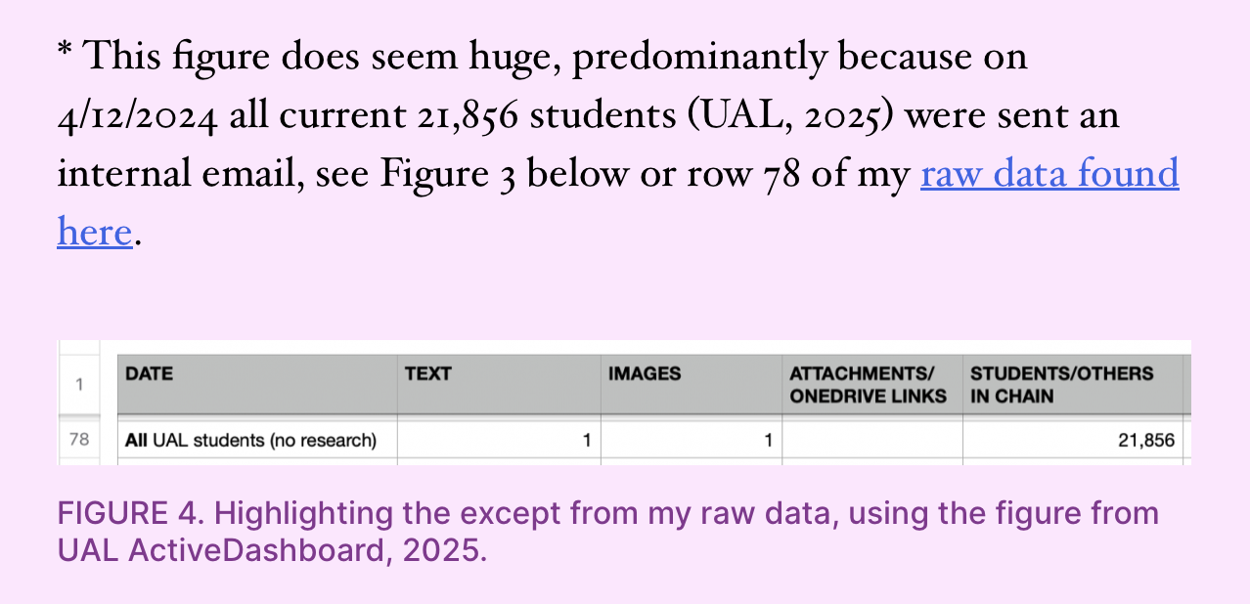
Appendices
How I calculated my CO2e:
Common occurrences:
Huge 22k Student number:
Notes:
Key takeaway here is that the impact is statistically meaningless

